Slide 1

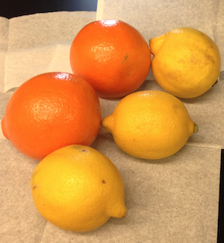

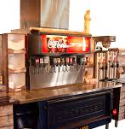
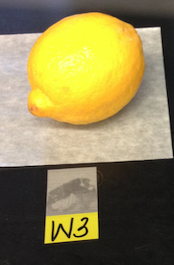
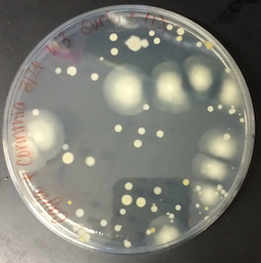
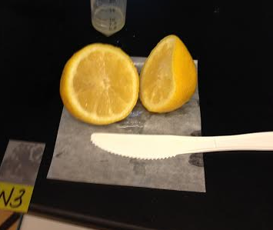
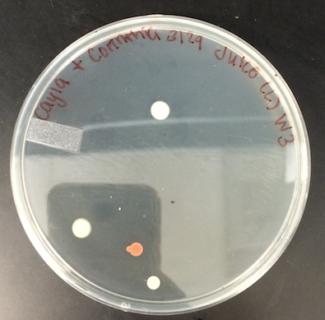
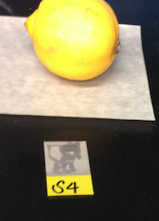
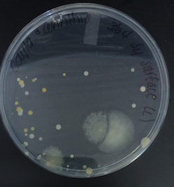
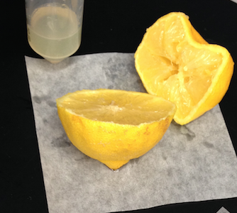
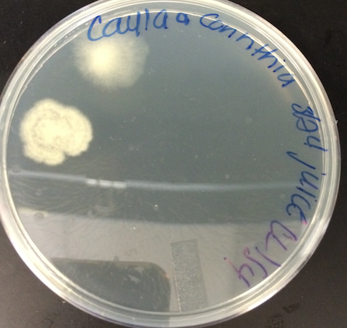
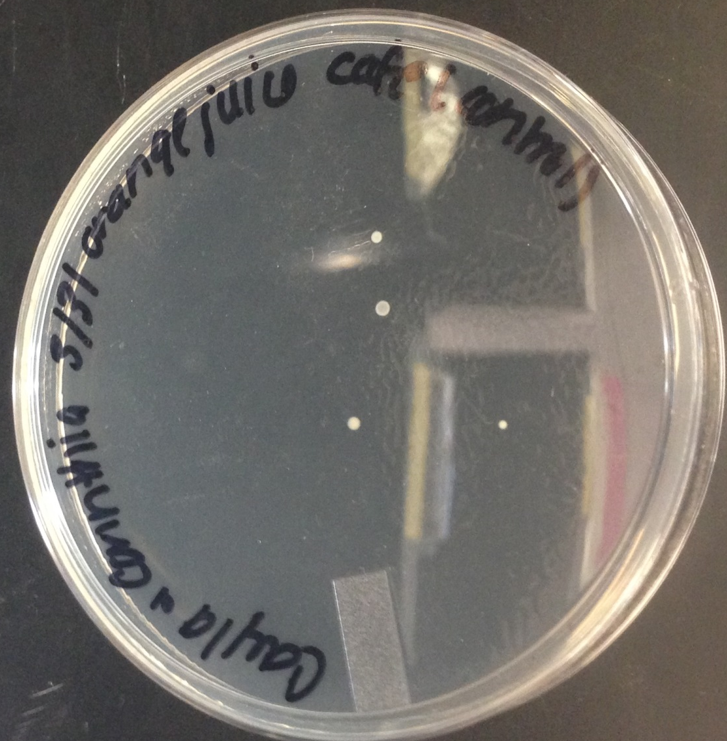
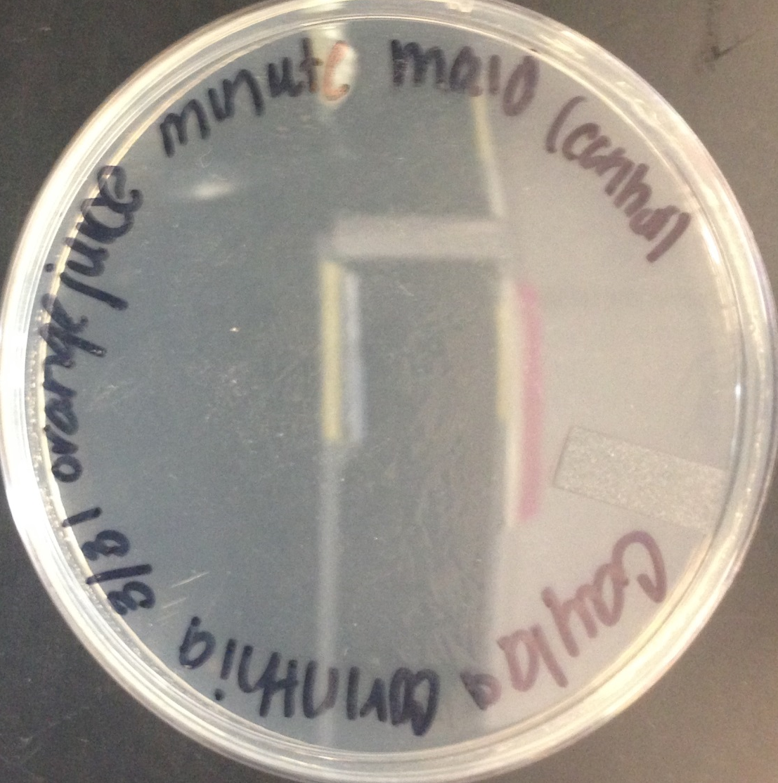
Freshly made or processed? A microbial look at orange juice and lemonade.
Cayla Lowe¹,Corinthia Wilkerson¹, and Hong Qin, PhD.¹ ¹Spelman College
ABSTRACT
RESULTS
RESULTS CONT.
Background: Lemon, lime, or orange slices are often placed on the rim of various beverage glasses. These citrus fruits add to the taste of the beverage as well as source of bioactive compound. The study is to help consumers realize that although we like the taste of these citrus fruits, they might also me adding contaminations to their body.
Aim: The purpose of the study is to investigate the relationship between the location of citrus fruit in respect to microbial growth.
Methods: The study investigated whether beverage lemon slices from institutional establishments contained more microbial contamination consumed by local grocery stores. Swabbed samples of the surface and filtered orange and lemon juice fresh oranges and lemons from local grocery stores and institutional establishments were analyzed for microbial contents.
Results: Our expected results are lemons from institutional established produced the most microbial growth with those from local grocery stores had the second highest amount of microbial growth.
Conclusion: We hope to conclude that individuals would make a safer choice when buying lemons from whole food stores than those at institutional establishments and grocery stores.
Sample of oranges and lemons from Walmart and Spelman cafeteria
Orange Juice Control from Walmart
Orange Juice control from Spelman cafeteria
Graph 1: displays no correlation between the colonies present in the juice versus colonies found on the surface of the samples
INTRODUCTION
CONCLUSION
Consuming fruit is very essential to healthy living as they provide vitamins, antioxidants, and other nutrients. Many may not realize that fruits also contain microbes on their surface as well as flesh. Contamination from non-sterile cooking utensils, microbes on hands, as well as bacteria that can be transferred to the fruit through transportation to distributors contribute to the amount of microbes that may be found on fruit. Oranges and lemons from a local grocery store as well as a college institution were tested to determine the amount of microbes on the skin and flesh of the fruits as well as the utensil that would be used. Our hypothesis is that the fruit from the college institution would have a greater amount of microbes than fruit from local grocery stores.
Lemon sample from Walmart (W3)
Plate containing 63 colonies on the surface of W3
Cut lemon sample from Walmart (W3)
Plate containing 5 colonies inside of W3
The hypothesis was not supported because there were more colonies found inside the oranges and lemons from Walmart
The surface of the oranges and lemons from Spelman cafeteria had more colonies
NEXT STEPS
Take swap samples from the cutting utensils found in Spelman cafeteria
Take swap samples of oranges, lemons, and cutting utensils found at various restaurant establishments
MATERIALS AND METHODS
Lemon sample from Spelman (S4)
Plate containing 35 colonies on the surface of S4
Cut lemon sample from Spelman (S4)
Plate containing 2 colonies inside of S4
The experiment consisted of obtaining oranges and lemons from the main cafeteria of Spelman College and Walmart Supercenter.
Flesh Experiment
Labeled oranges and lemons from Spelman at S1, S2, S3 and labeled oranges and lemons from Walmart as W1, W2, and W3.Labeled the plates with name of researchers, date, location, either orange or lemon surface. Swapped the surface of the oranges and lemons thoroughly with a cotton swap and then displaced the cotton swap in the bio waste. Used four knives to cut open each orange and lemon, but to ensure that the cutting utensils were sterile, the researchers divided a plate in four and collected a cotton swap of each knife.
Filtered Juice Experiment
Using a different knife for each orange and lemon, they were cut in half and squeezed. The juice from each fruit was collected in separate falcon tubes. To ensure that the juice was filtered, we let it sit for a few minutes so that all of the seeds could float to the bottom. Labeled the plates with name of researchers, date, location, either orange or lemon juice. Measured 100ul of the juice collected from the falcon tube and placed on the respected plate. Added 4 beads to each plate to ensure equal spreading of the filtered juice. Let the places sit at room temperature for a week.
Control Experiment
Obtained orange juice from the main cafe at Spelman College and Minute Maid brand. Labeled oranges juice as cafe and Minute Maid. Labeled the plates with name of researchers, date, location, either cafe or minute maid.
Measured 100ul of the juice collected from the falcon tube and placed on the respected plate. Added 4 beads to each plate to ensure equal spreading of the filtered juice.
Let the plates sit at room temperature for a week.
Counted each plate for data analysis.
REFERENCES
1.Walczak, D.; Reuter, M. Putting restaurant customers at risk: unsafe food handling as corporate violence. International Journal of Hospitality Management Volume 23, Issue 1, March 2004, Pages 3-13
2. Loving, A; Perz, J. Microbial Flora on Restaurant Beverage Lemon Slices. National Environmental Health Association 2007
3. Adegoke, G.O., Iwahashi, H. Komatsu, Y.
Obuchi, K. & Iwashi, Y. (2000). Inhabitants of food spoilage yeasts and aflatoxigenic moulds by monoterpenes of the spice Aframonum Danielle. African Journal of Biotechnology, 2(9), 254-263
4. Cheak, L.H. and Tran, T.B. (1995). Postharvest biocontrol of Penicillum rot of lemons with industrial yeast. In Proceeding of the 48th New Zealand Plant Protection Conference. Retrieved February 10, 2014
5. Tufarelli, M. Love your lemons. Pioneer Thinking. Retrieved February 10, 2014, from http://www.pioneerthinking.com/rbt14.html
Plate containing 3 colonies from the control orange juice from Spelman cafeteria
Plate containing no colonies on the control orange juice, Minute Maid, from Walmart
Table 1 presents orange and lemon samples from Spelman College and Walmart with the amount of colonies counted
Table 2 presents the control samples from Walmart (C1-C3) and Spelman College (C4-C6)
 | Surface (number of colonies) | Juice (number of colonies)
W1 | 13 | 0
W2 | 1 | 4
W3 | 63 | 5
S1 | 5 | 0
S2 | 4 | 2
S3 | 41 | 1
S4 | 35 | 2
S5 | 12 | 1
 | Juice (number of colonies)
C1 | 7
C2 | 4
C3 | 3
C4 | 0
C5 | 0
C6 | 0
ACKNOWLEDGMENTS
.
I wish to acknowledge the help provided by Corinthia Wilkerson and Dr. Qin.

